Slide 1


EnerTest Solutions Intro
A trusted engineering partner for battery testing and production system integration.
www.EnertestSolutions.com

Slide 2

Who We Are
An Engineering-focused team with solid experience in battery manufacturing and testing.
Based in the United States with complete project delivery capability:
• Technical sales
• On-site installation and commissioning
• After-sales service and technical support
• Project management and logistics
Strategic access to leading battery manufacturing and test-equipment partners in China, helping ensure advanced technology and competitive delivery.

Slide 3
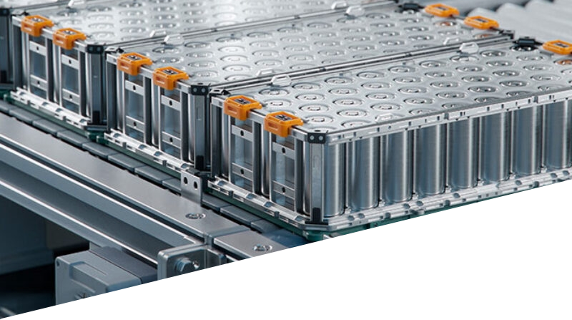
What Problems Do We Solve?
Industry Pain Points
EnerTest Value Proposition
• There are few U.S.-based suppliers with real experience in battery cell, module, and pack production lines.
• Local suppliers are often expensive and slow to deliver, making it difficult for customers to ramp up quickly.
• Many overseas equipment makers lack stable local engineering support, increasing implementation and commissioning risk.
• Slow after-sales response can affect uptime, maintenance efficiency, and line optimization.
• Some equipment is not fully prepared for U.S. safety and compliance requirements such as UL, NFPA, and NEC.
• Industry-proven production equipment and technology backed by mature battery manufacturing resources.
• Carefully selected suppliers combined with system integration capability to help improve ROI and shorten ramp-up time.
• Local U.S. engineering participation from concept design through site implementation.
• Fast technical support and after-sales response to keep the line running steadily.
• Localization and engineering standardization, including HMI optimization and UL / NFPA-oriented design support.
• System-level project management for complex battery production programs, covering procurement, logistics, customs, and DDP delivery.

Slide 4
Core Strengths
Access to Leading Manufacturing Resources
Access to proven battery equipment makers
Coverage from cell to module and pack
Competitive cost and lead time
Support for customization and solution optimization
Battery Manufacturing Process Expertise
Understanding of key module and pack processes
Ability to match process flow with equipment selection
Design focused on consistency, takt time, and yield
Problem-solving for real production scenarios
Project Management & Delivery
Coordination of schedule, quality, and risk
Multi-supplier interface management
Cross-border procurement, logistics, and customs
DDP delivery capability
Compliance-Driven Engineering
Understanding of UL / NFPA / NEC design expectations
Localized HMI and electrical standards
Safer implementation for U.S. projects
Reduced downstream rework risk
Local Execution
Local technical sales support
On-site installation and commissioning
FAT / SAT coordination
After-sales response and closed-loop problem solving

Slide 5
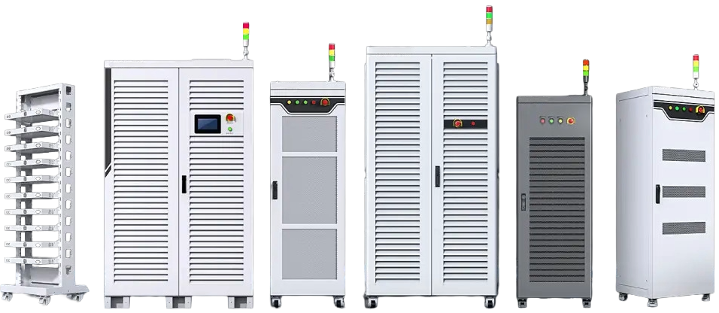
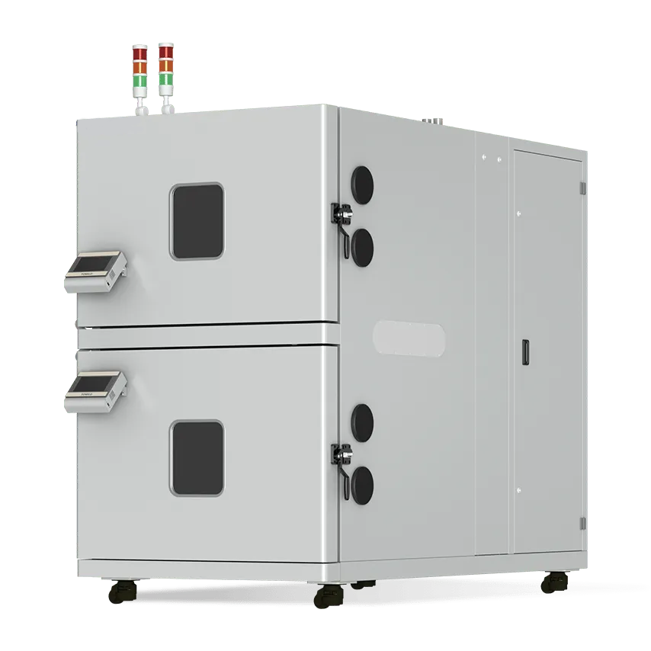
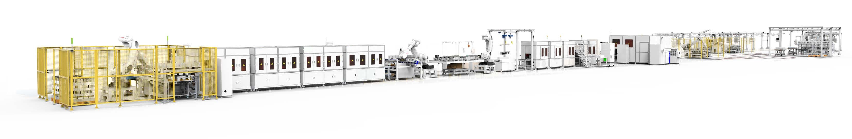
Products & Business Scope
Raw Material Testing
Powder Resistivity & Compaction Density Systems, Flatness Inspection Systems, Particle Magnetic Bed Equipment
Casing Pressure Test Equipment
Test System
Solutions
Cell / Module / Pack Cyclers
Explosion-Proof Temp Chambers
Liquid Cooling Systems / Chillers
Pressure Fixtures & DAQ Systems
Cell Charge / Discharge Fixtures
CAN Test & Data Logging Systems
NGI Cell Simulators
HIL Test Platforms
Finished Product Testing
(Cell / System Level)
Cell Mfg. Lines
Production &
Automation
Sorting
Module / Pack Lines
System Eng. & Integration
Engineering
Services
On-Site / Remote Tech Support
Balancer
Automation / Utility SW & Test Logic
Maintenance
& Auxiliary
Recharge Unit
Custom Test Tools & Fixtures
Localization & Compliance Support
Other Equipment (e.g., relay testers, insertion / extraction force testers)

Slide 6
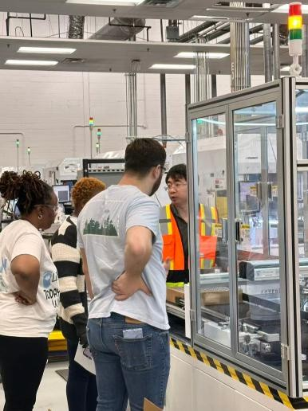
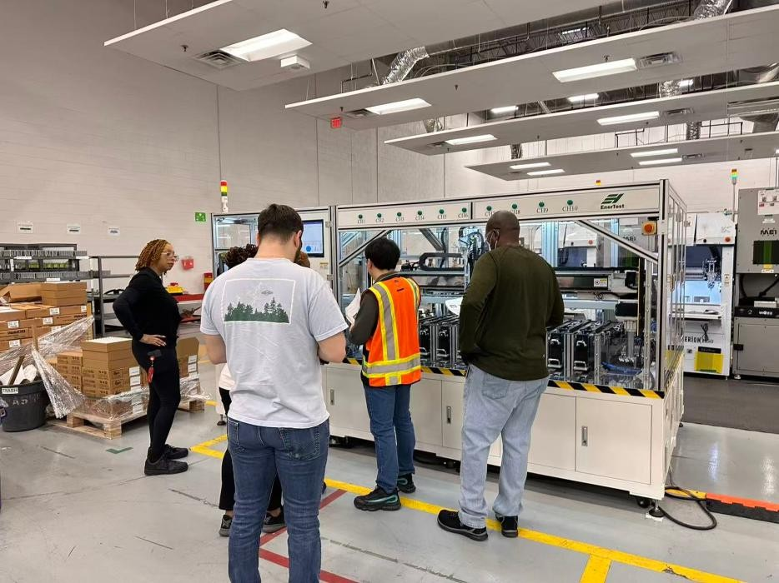
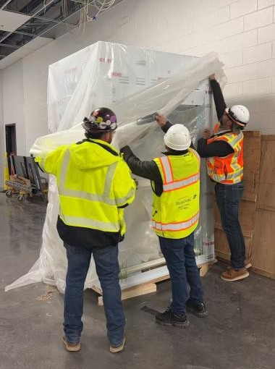
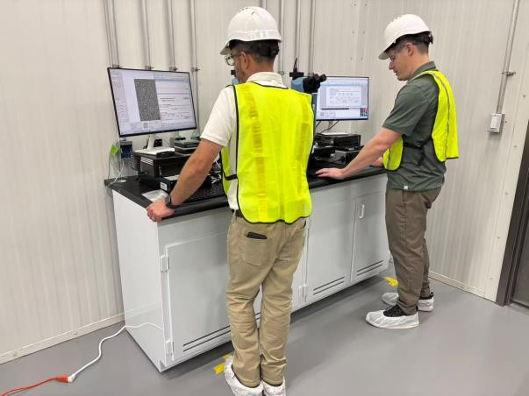
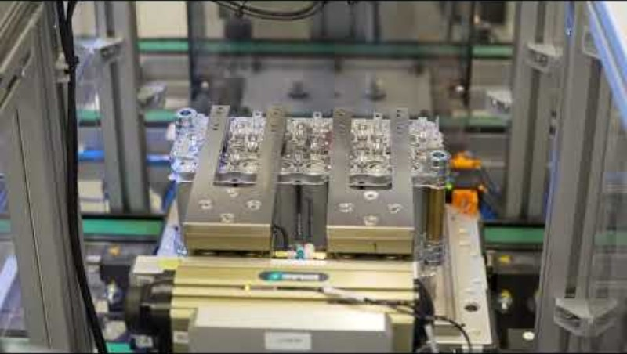
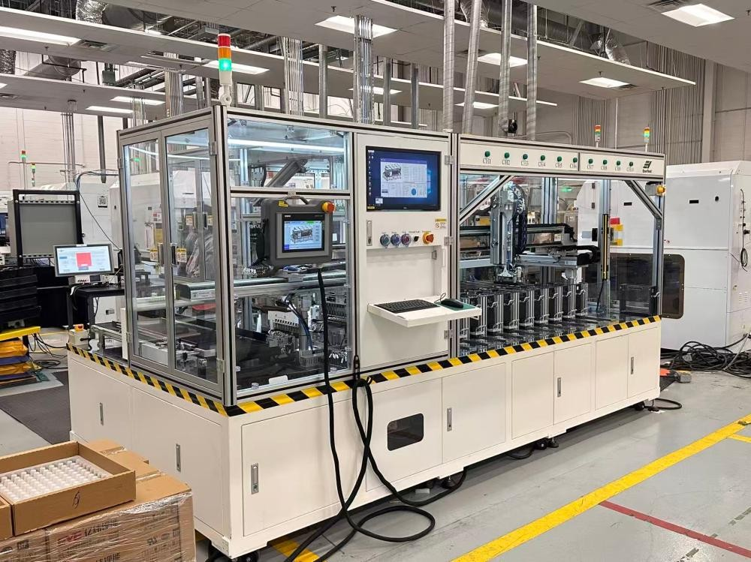
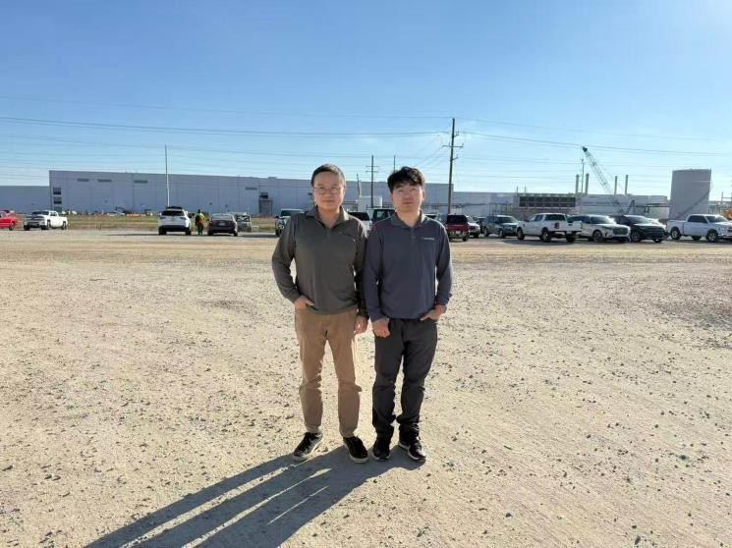
Customer Project Reference Book
Location: Marshall, MI
Delivered Equipment: Battery Manufacture IQC Equipment， QA Lab Equipment; Battery Testing Accessories and Parts;
Completed Services: Commissioning and Application Support
Location: Stone Mountain, GA
Delivered Equipment: Battery Manufacture Line System
Completed Services:
Engineering design, machine build, commissioning and production support
Source: Customer-published public video; equipment supplied by Enertest.

Slide 7
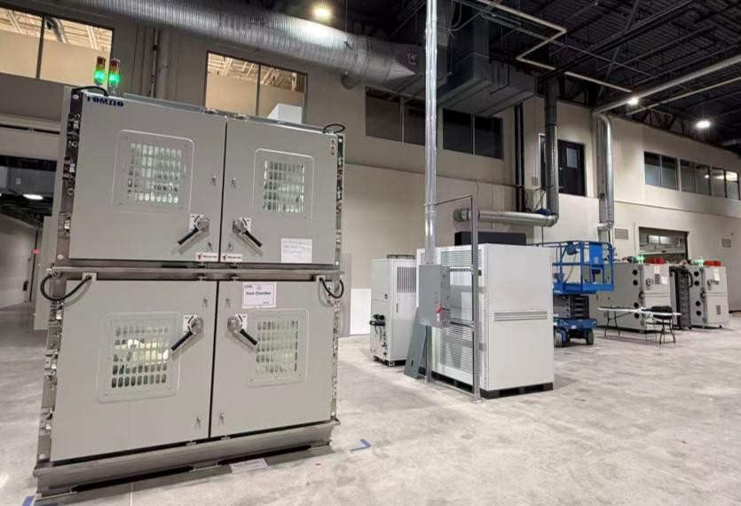
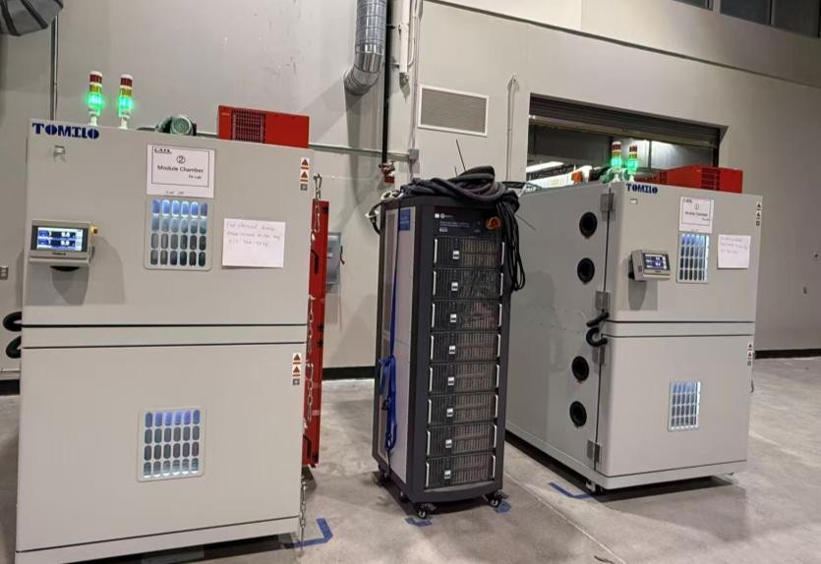
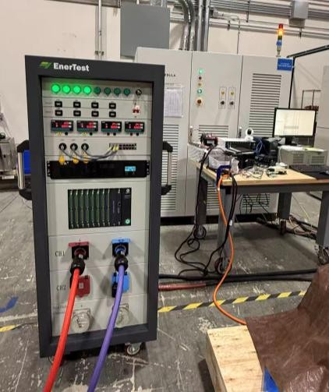
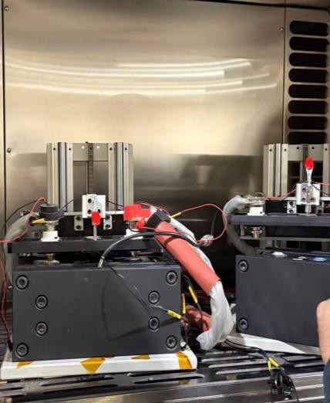
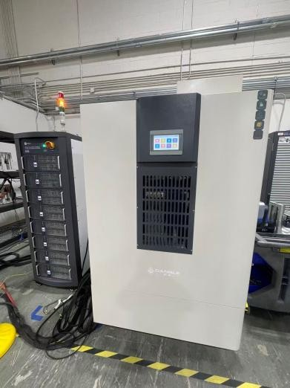
Customer Project Reference Book
Location: Auburn Hills, MI
Delivered Equipment:
Battery Cell/Module/Pack Cycler
Double-deck Battery Cell Climatic Test Chamber
Double-deck Battery Pack Climatic Test Chamber
BMS HiL Test System
Customization Testing Instrumentation & Accessories
Completed Services:
Engineering design, commissioning and application support

Slide 8
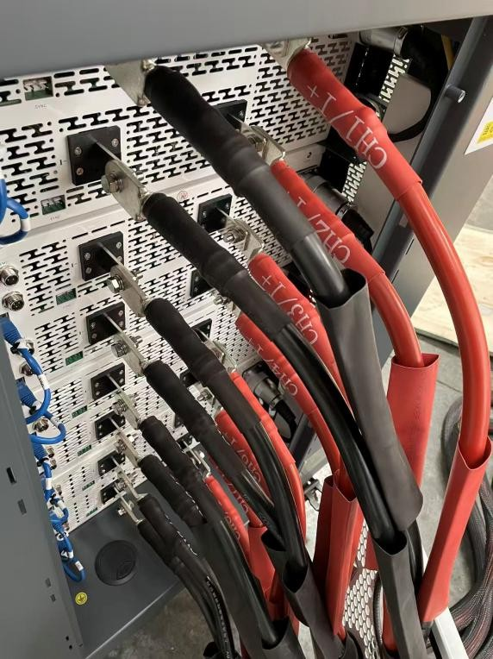
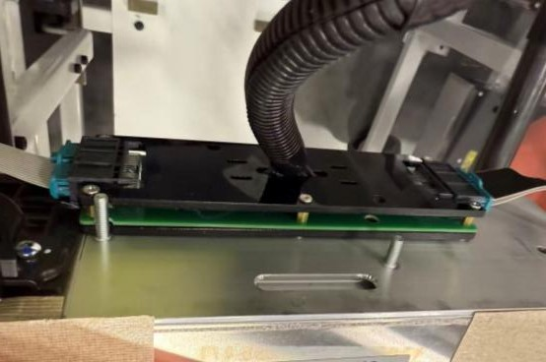
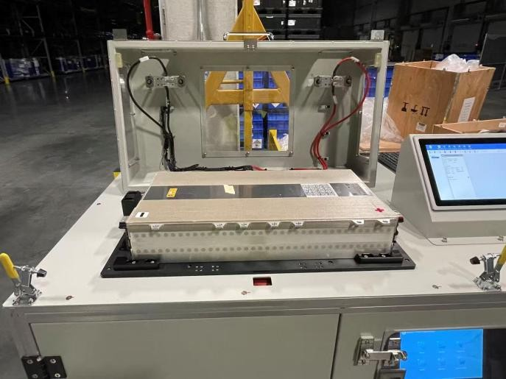
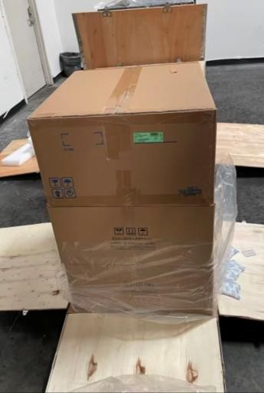
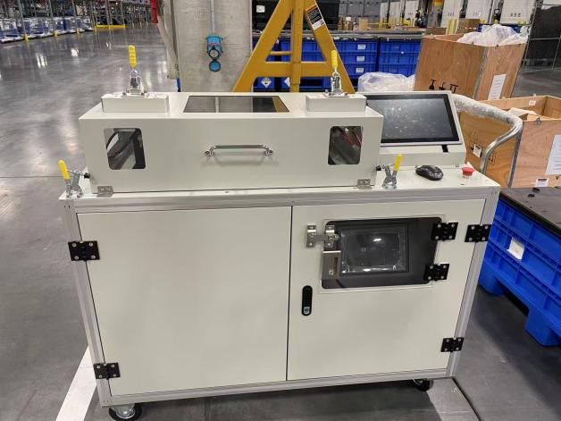
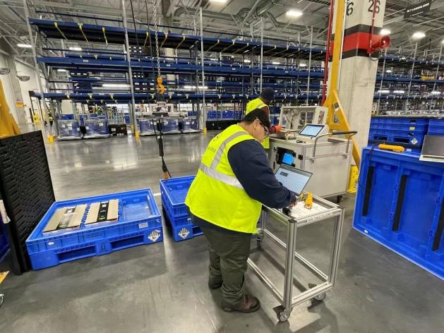
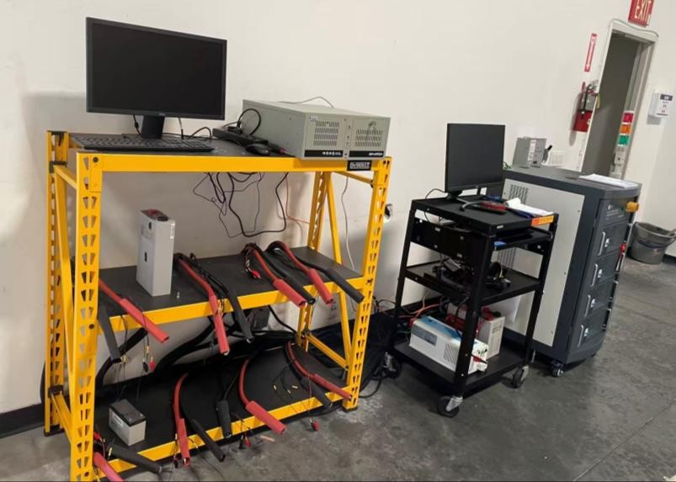
Customer Project Reference Book
Location: Tuscaloosa, AL
Delivered Equipment: Automated Battery Module Repair Workbench
Completed Services:
Custom Engineering Solution for Automated Battery Module Balancing & Repair
Location: La Puente, CA
Delivered Equipment: Battery Cell Cycler 5V300A8CH
Completed Services: Commissioning, Training and Application Support

Slide 9
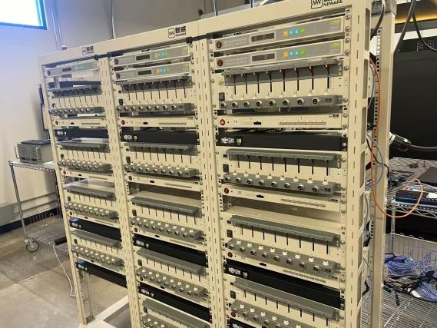
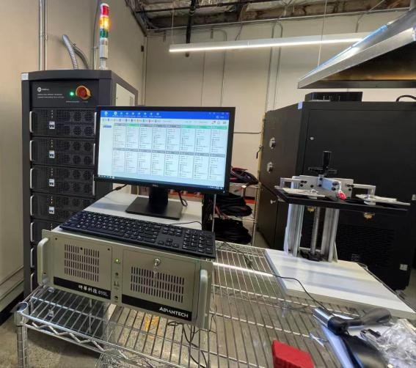
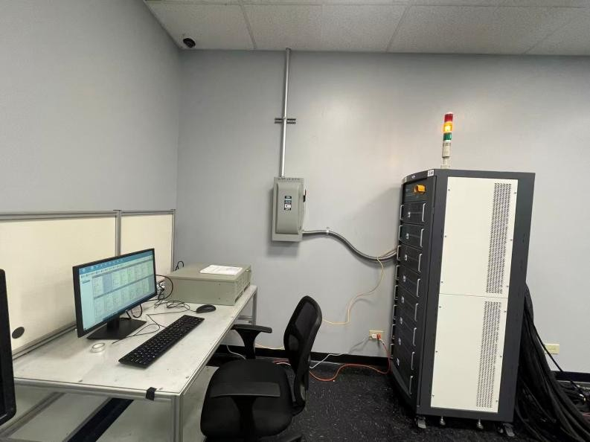
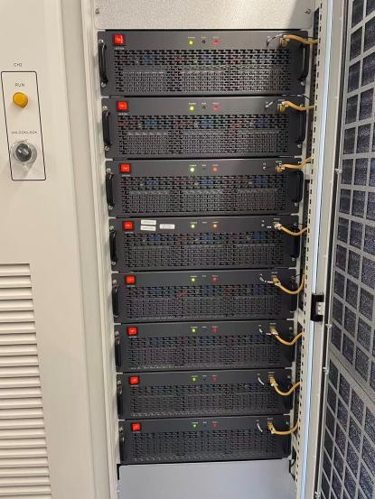
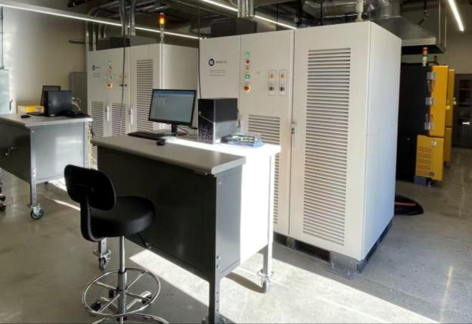
Customer Project Reference Book
Location: Grand Prairie, TX
Delivered Equipment: Battery Cell Cycler 5V300A16CH
Completed Services: Commissioning, Training and Application Support
Location: Sunnyvale, CA
Delivered Equipment: Battery Cell Cyclers, Battery Module/Pack Cyclers
Completed Services: Commissioning, Training and Application Support

Slide 10
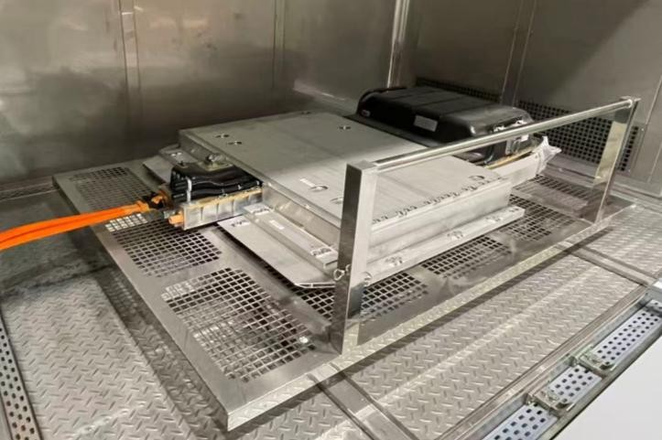
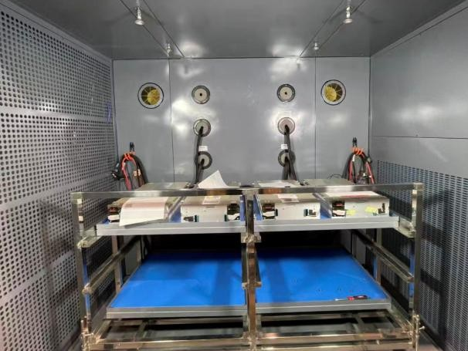
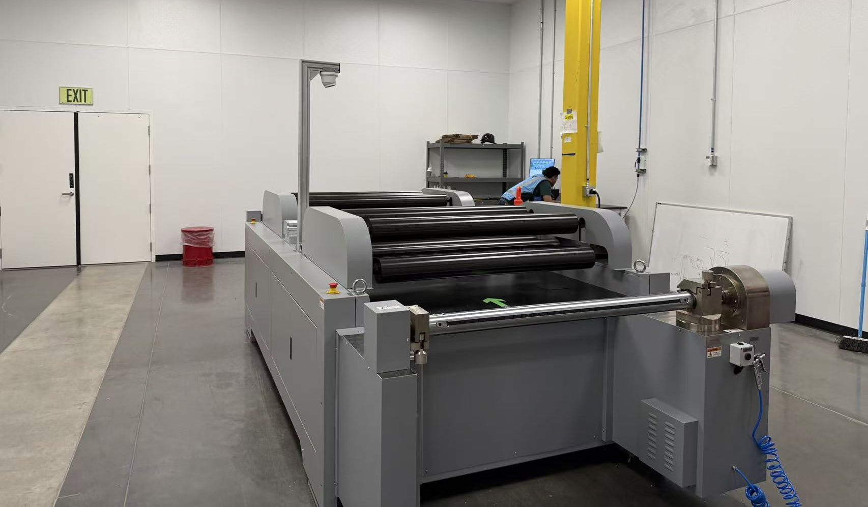
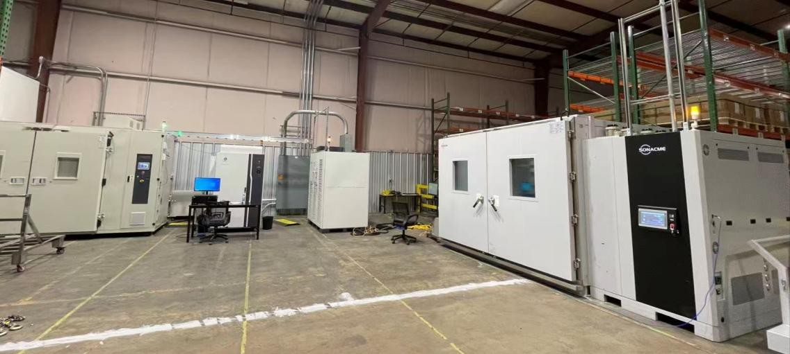
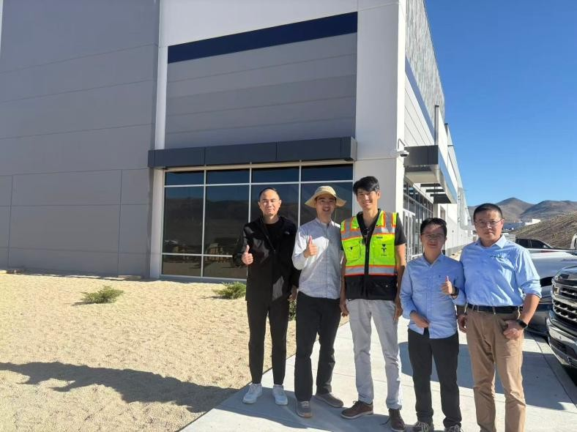
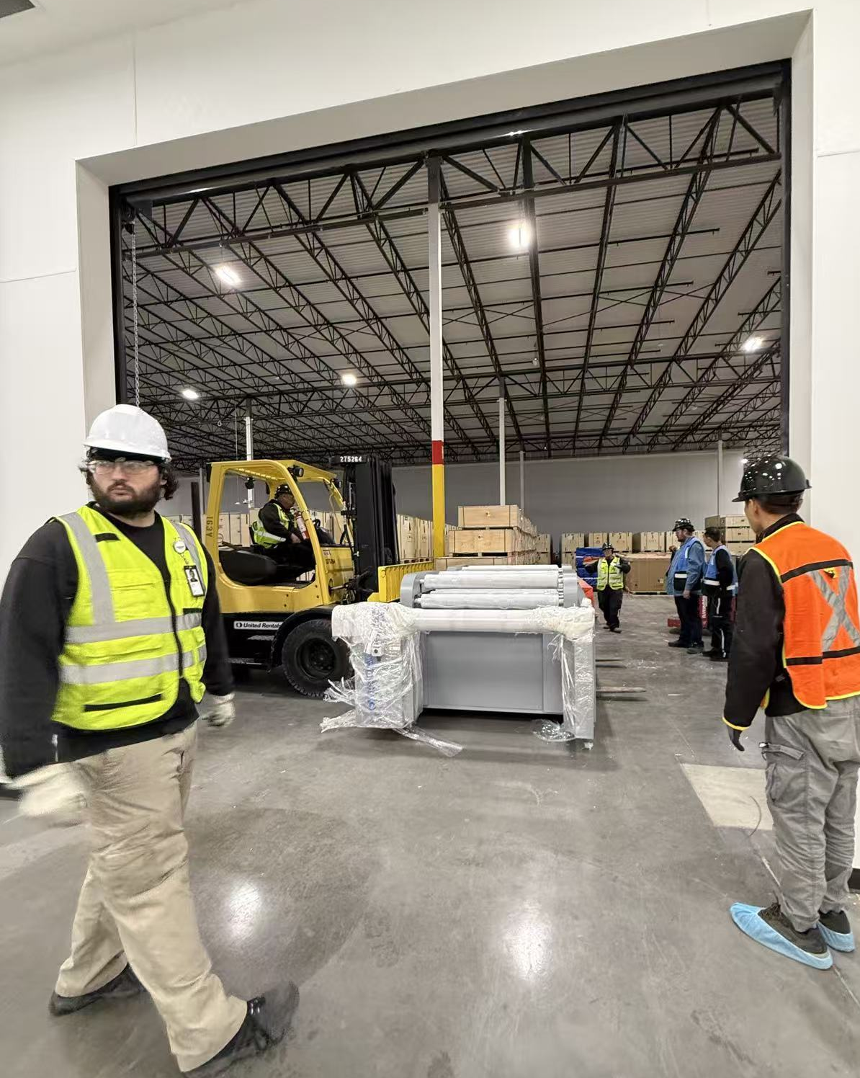
Customer Project Reference Book
Location: Reno, NV
Delivered Equipment: QA Lab Equipment; IQC Equipment
Battery Testing Accessories and Parts;
Completed Services:
Commissioning and Application Support
Location: Tuscaloosa, AL
Delivered Equipment:
Battery Module/Pack Cycler, Walk-In Battery Test Chamber
Completed Services:
Engineering design, commissioning and application support

Slide 11
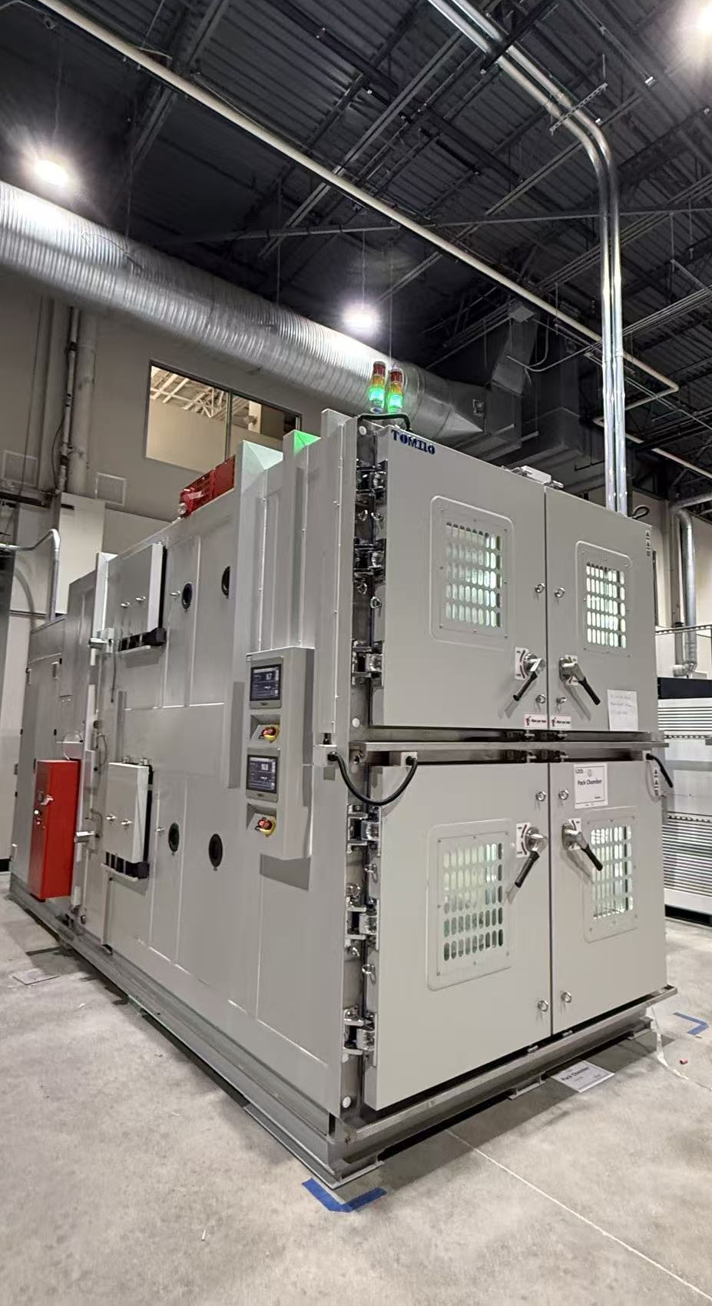
EnerTest Solutions
Project Delivery Process
01
02
03
04
Requirements &
RFQ Alignment
Technical Review &
System Design
Proposal /
Contract
System Integration &
FAT
07
06
05
Technical Support &
Long-Term Service
Training &
System Handover
Installation,
Commissioning & SAT

Slide 12











Customers
OEMs & Vehicle Manufacturers
Ford | Tesla | Mercedes-Benz
Battery Manufacturers
CATL | BYD | Farasis
Testing & Certification Laboratories
Eurofins
Industrial & Energy Companies
Briggs & Stratton | Re-Tech
Academic Institutions
Henry Ford College | Tennessee Tech

Slide 13
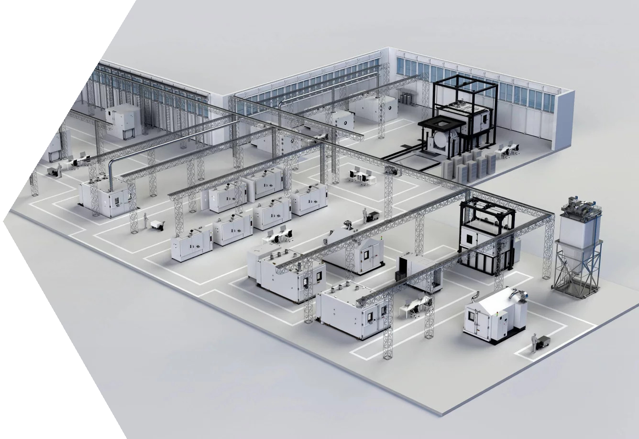
Our Positioning
1
We are not just an equipment seller. We design and implement turnkey battery testing systems.
2
3
We help customers build long-term, sustainable battery testing/ manufacturing capability.
We act as an extension of the customer engineering team throughout design, implementation, and optimization.

